Slide 1


<Name>
<Date>

Slide 2

Outline
Executive Summary
Introduction
Methodology
Results
Conclusion
Appendix

Slide 3
Executive Summary
Summary of methodologies
Goal to accurately predict success of SpaceX launches
Collected launch data from SpaceX API and webscraping Wikipedia
Executed feature engineering to classify successes and failures
Exploratory data analysis to understand relationships between variables using visualizations
More feature engineering with one hot encoding and scaling to preprocess for training models
Split the data and used cross validation
Tested several different methods (Logistic Regression, SVM, Decision Tree, and KNN)
Summary of all results
All models rendered the same accuracy of 83.3% most likely due to a small dataset and all had the same resulting confusion matrix

Slide 4
Introduction
Project background and context
Wanted to predict the success of SpaceX launches based on historical data
Problems you want to find answers
Wanted to understand what variables had the greatest affect on a successful launch

Slide 5

Section 1

Slide 6
Methodology
Executive Summary
Data collection methodology:
Data was collected using SpaceX API and webscraping html tables from wikipedia
Perform data wrangling
Data was processed by numerically encoding successes and failures
Perform exploratory data analysis (EDA) using visualization and SQL
Perform interactive visual analytics using Folium and Plotly Dash
Perform predictive analysis using classification models
Built and tested LR, SVM, Decision Tree, and KNN models

Slide 7
Data Collection
Describe how data sets were collected.
Datasets were collected from SpaceX API and webscraping html table from Wikipedia
You need to present your data collection process use key phrases and flowcharts
SpaceX API
Pandas Dataframe
Get Request

Slide 8
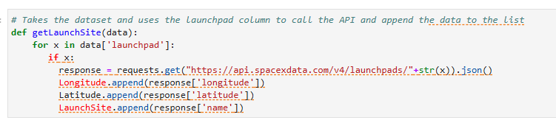
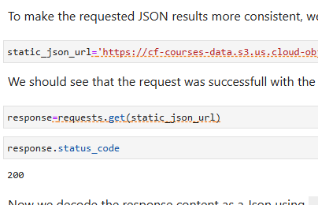
Data Collection – SpaceX API
SpaceX API
Get Request
Pandas Dataframe
See relevant py files at https://github.com/dborden89/SpaceY

Slide 9
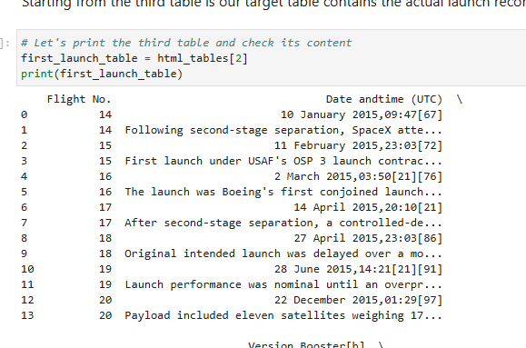
Data Collection - Scraping
Present your web scraping process using key phrases and flowcharts
See relevant py files at https://github.com/dborden89/SpaceY
WIkipedia
Beautiful Soup
Pandas Dataframe

Slide 10
Data Wrangling
Describe how data were processed
# landing_class = 0 if bad_outcome#
landing_class = 1 otherwiselanding_class = [ 0 if 'False' in str(outcome) or 'None' in str(outcome) else 1 for outcome in df['Outcome']]print(landing_class)
See relevant py files at https://github.com/dborden89/SpaceY

Slide 11
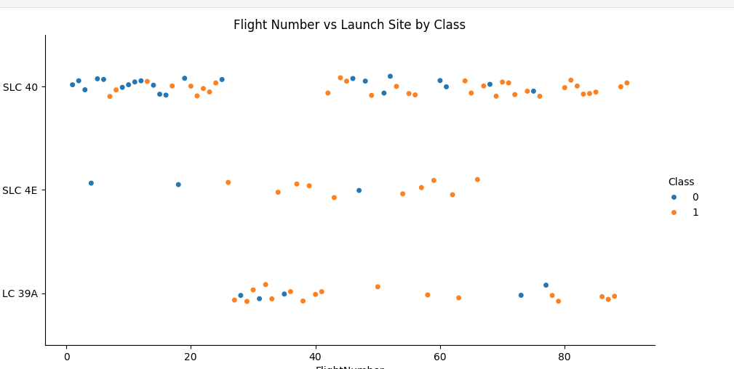
EDA with Data Visualization
Used scatter plots, bar charts, and line charts to understand how different features affected launch outcomes
See relevant py files at https://github.com/dborden89/SpaceY

Slide 12
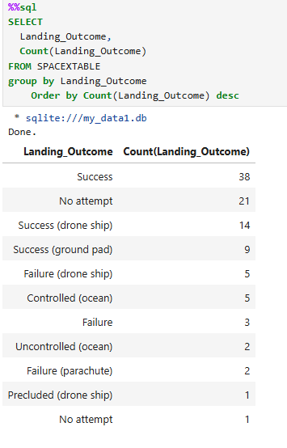
EDA with SQL
Grouped successes and failures
Grouped months to see failure count conditioned on drone ships
Grouped outcomes
See relevant py files at https://github.com/dborden89/SpaceY

Slide 13
Build an Interactive Map with Folium
Added circles and markers based on launch site location and if those launches had successful outcomes or not.
The markercluster is really great especially if you have multiple events at the same coordinates.
We addressed those objects to understand success rate at each launch location
See relevant py files at https://github.com/dborden89/SpaceY

Slide 14
Build a Dashboard with Plotly Dash
We added pie charts of success and failure rates by different launch site location
We used scatter plot to plot outcome over payload and color-labeled each scatter point by Booster version
Filter for each location affected both
These plots allowed us to understand how launch site and payload affected outcomes
See relevant py files at https://github.com/dborden89/SpaceY

Slide 15
Predictive Analysis (Classification)
Turned Predictors and Target Variable into separate arrays
Scaled the predictor variables using StandardScaler
Did a train_test_split of .2
Cross validation with 10 k folds
LR model
parameters ={'C':[0.01,0.1,1], 'penalty':['l2'], 'solver':['lbfgs’]}
tuned hpyerparameters :(best parameters) {'C': 0.01, 'penalty': 'l2', 'solver': 'lbfgs’}
accuracy : 0.8464285714285713
Also tested SVM, Decision Tree, and KNN
See relevant py files at https://github.com/dborden89/SpaceY

Slide 16
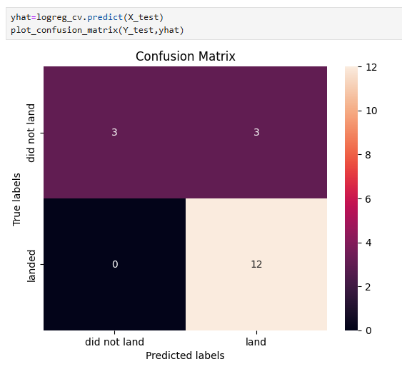
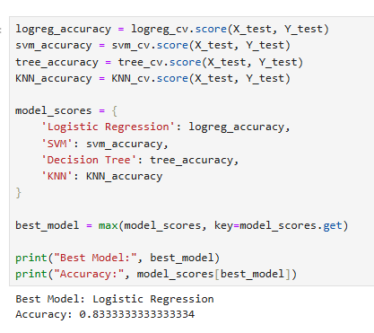
Results
LR for the win
Accuracy of 83.3% on test set

Slide 17

Section 2

Slide 18
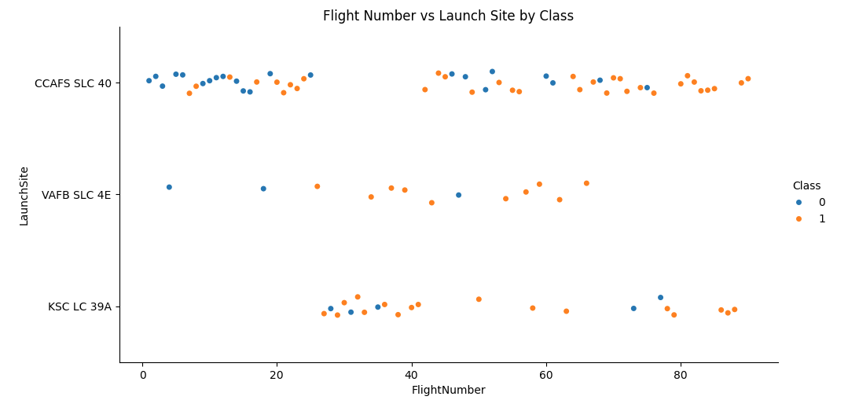
Flight Number vs. Launch Site
More successes with increases in flight number
More launches at CCAFS SLC 40

Slide 19
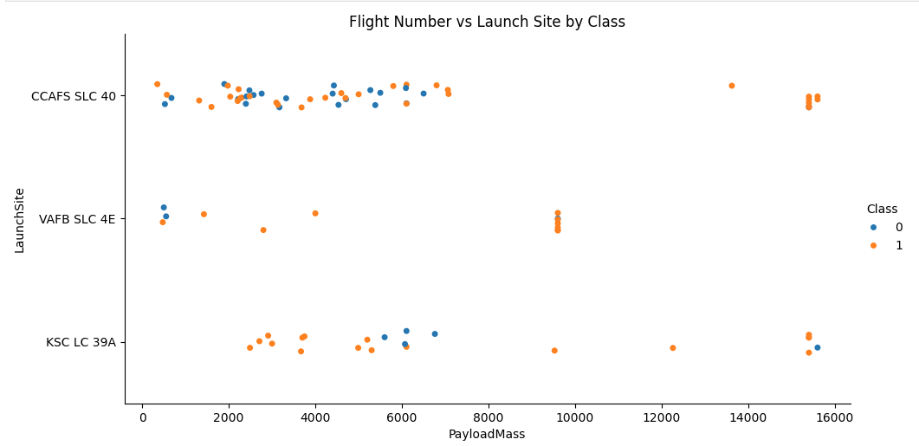
Payload vs. Launch Site
More successes with higher payload mass

Slide 20
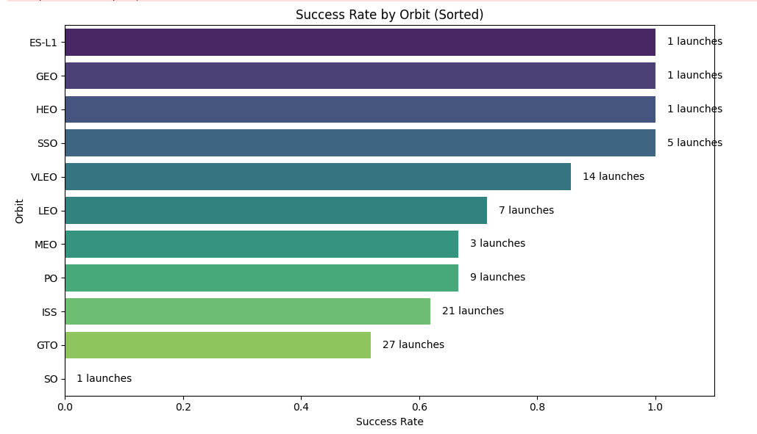
Success Rate vs. Orbit Type
Great success at SSO and VLEO orbits in relation to attempts.
Very poor rates at ISS and GTO orbits

Slide 21
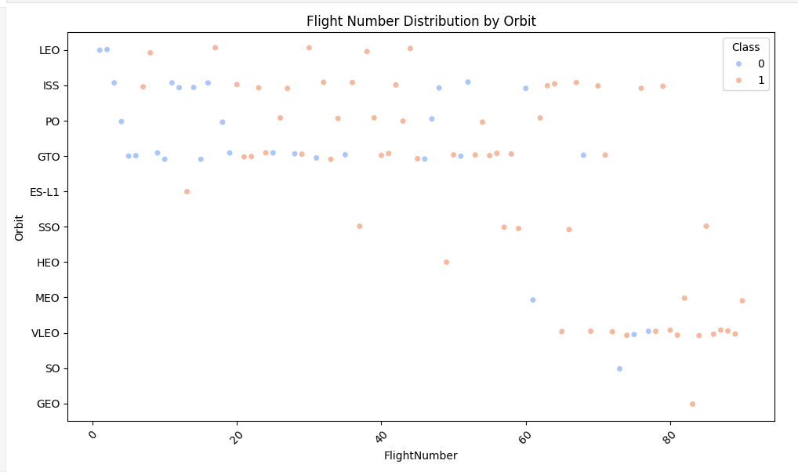
Flight Number vs. Orbit Type
Recent launches concentrated in VLEO orbit

Slide 22
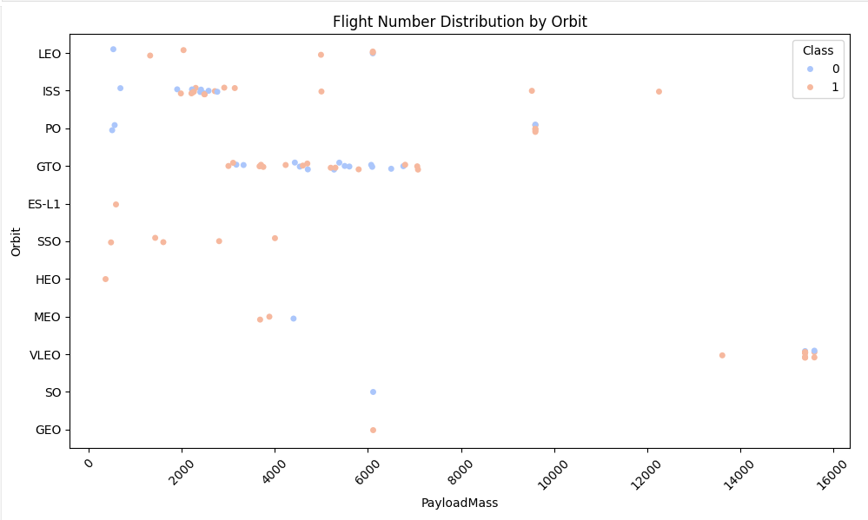
Payload vs. Orbit Type
Most payloads under 7000
Large variation in ISS

Slide 23
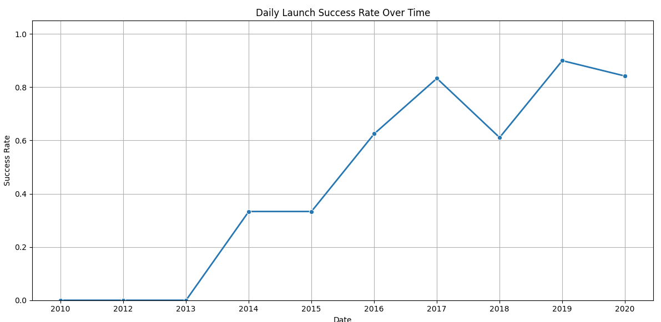
Launch Success Yearly Trend
Success rate increasing over time

Slide 24
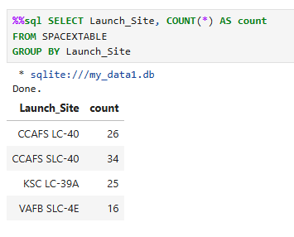
All Launch Site Names
Find the names of the unique launch sites
This query groups launch sites and gives a count of each record in the dataset

Slide 25
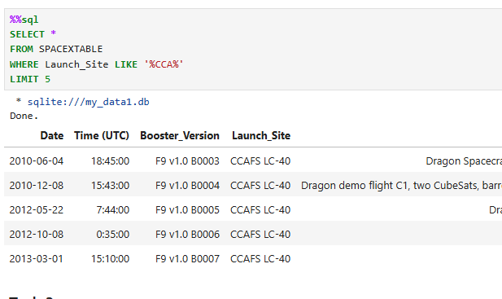
Launch Site Names Begin with 'CCA'
Find 5 records where launch sites begin with `CCA`
Uses like function to get relevant launch site and limits to first 5 records

Slide 26
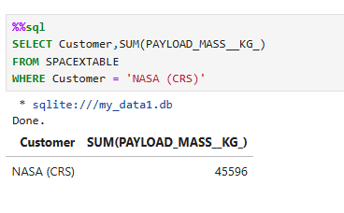
Total Payload Mass
Calculate the total payload carried by boosters from NASA
Users where clause to focus on relevant Customer and Sum function to get total payload mass for that customer

Slide 27
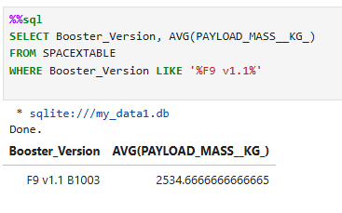
Average Payload Mass by F9 v1.1
Calculate the average payload mass carried by booster version F9 v1.1
Uses average function and where clause

Slide 28
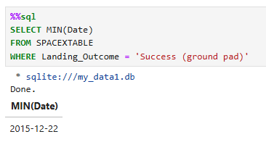
First Successful Ground Landing Date
Find the dates of the first successful landing outcome on ground pad
Uses min function and where clause for output

Slide 29
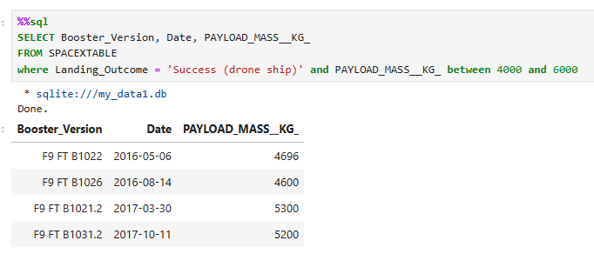
Successful Drone Ship Landing with Payload between 4000 and 6000
List the names of boosters which have successfully landed on drone ship and had payload mass greater than 4000 but less than 6000
Use where and between clause to get output

Slide 30
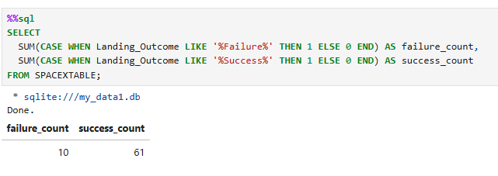
Total Number of Successful and Failure Mission Outcomes
Calculate the total number of successful and failure mission outcomes
Uses Sum function and case statement to get failures and successes

Slide 31
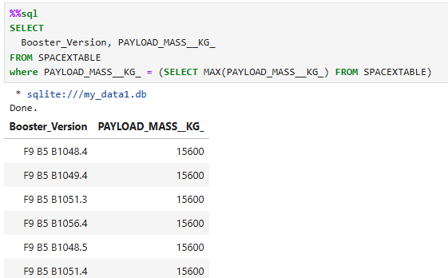
Boosters Carried Maximum Payload
List the names of the booster which have carried the maximum payload mass
Uses select in where clause as a subquery

Slide 32
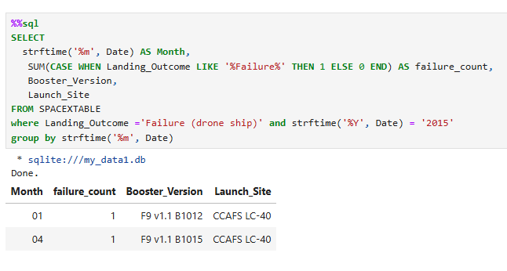
2015 Launch Records
List the failed landing_outcomes in drone ship, their booster versions, and launch site names for in year 2015
Had to parse out month from Date field, used sum function, case statement for failure count, where clause and group by clause

Slide 33
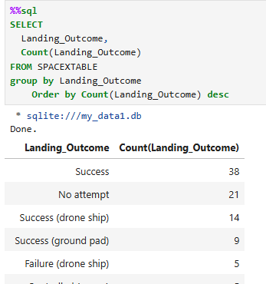
Rank Landing Outcomes Between 2010-06-04 and 2017-03-20
Rank the count of landing outcomes (such as Failure (drone ship) or Success (ground pad)) between the date 2010-06-04 and 2017-03-20, in descending order
Used Count, group by, and order by in descending

Slide 34

Section 3

Slide 35
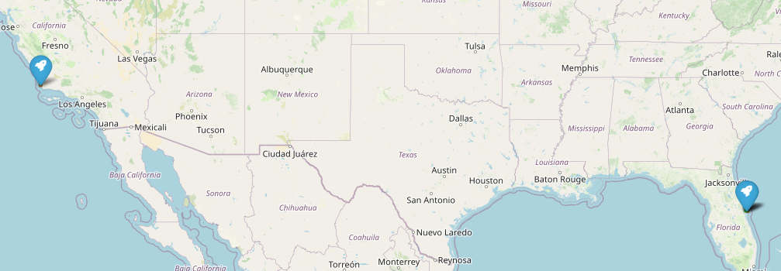
SpaceX Launch Sites
Launches took place in Florida and California with most in Florida as it hosted three of the four launch sites
Explore the generated folium map and make a proper screenshot to include all launch sites’ location markers on a global map
Explain the important elements and findings on the screenshot

Slide 36
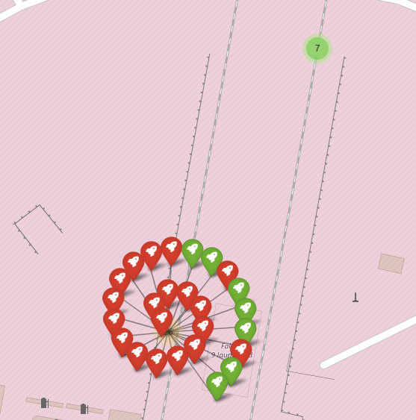
Map with Success Markers
Includes markers that depicts if outcomes was a success or failure
Shows two launch sites in Florida

Slide 37
<Folium Map Screenshot 3>
Replace <Folium map screenshot 3> title with an appropriate title
Explore the generated folium map and show the screenshot of a selected launch site to its proximities such as railway, highway, coastline, with distance calculated and displayed
Explain the important elements and findings on the screenshot

Slide 38

Section 4

Slide 39
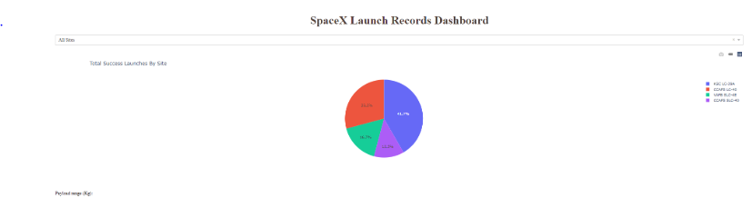
Success by Launch Site
Most successes happened at KSC LC-39A

Slide 40
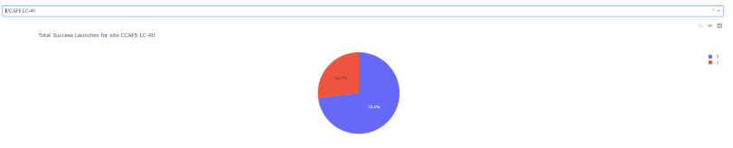
Most Successful Launch Site
Launch site with the highest success rate

Slide 41
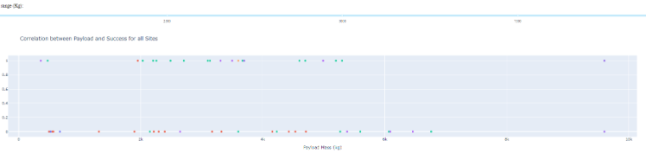
Payload by Success Rate
Scatter plot displaying outcome over payload and color-labeled by booster version

Slide 42

Section 5

Slide 43
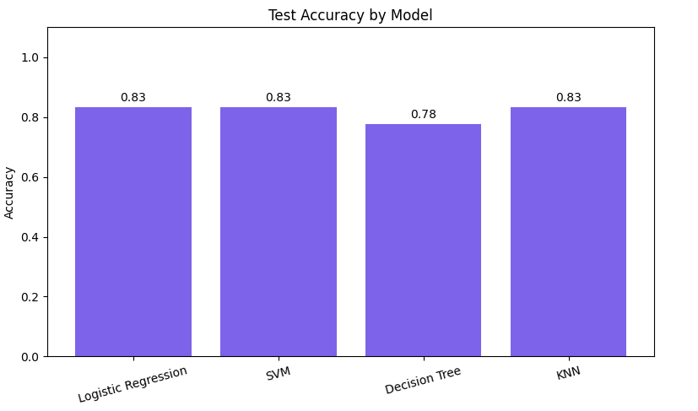
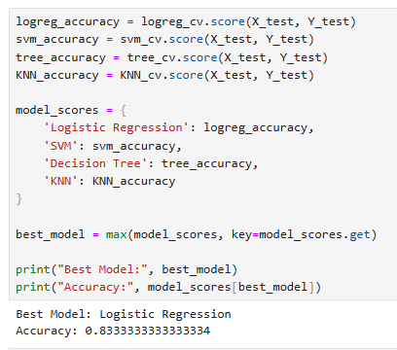
Classification Accuracy
LR for the win!!!

Slide 44
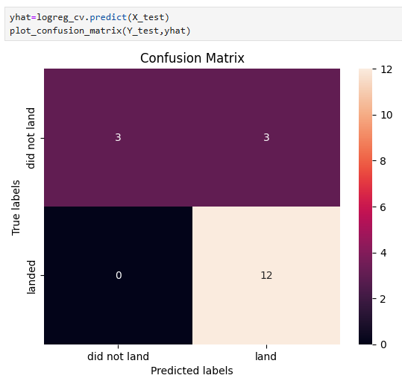
Confusion Matrix
LR Confusion matrix
12 True Positives
3 True Negatives
3 False Positives
Accuracy of 83.3%

Slide 45
Conclusions
Collecting and processing data is the most critical step in the process. You must develop quality data to produce quality models
SQL was a powerful tool used to summarize the data in a result set and quickly understand data in a concise tabular format
Visualization is key in understanding relationships between variables and drove tremendous insight into variables affecting outcomes
Logistic regression was the favored model in predicting SpaceX launch outcomes with an accuracy of 83.3%

Slide 46
Appendix
Include any relevant assets like Python code snippets, SQL queries, charts, Notebook outputs, or data sets that you may have created during this project

Slide 47


